Slide 1
WP6: Architecture and Integration
Alex Kofman (IBM)

Slide 2
Outline
Architecture for Integrated Prototype
Requirements, Constraints, Guidelines
Conceptual Architecture
Technology stack choice
Component architecture
Development lifecycle support – dev, test, deploy
Some design questions
Computing Infrastructure for each use case
General overview
Traffic
FeedZai
Open Issues and Next Steps

Slide 3
Architecture for integrated prototype
WP6: Architecture and Integration

Slide 4
Requirements and Architectural Guidelines
Scalability, Performance
Traffic use case – 2K events/sec
Credit Card Fraud use case – 1K events/sec, <25ms latency
Fault-tolerance – not critical (for prototype) but yet important
Node, communication, computational failures
Connectivity
Support high-throughput messaging systems
Programming model, language
Language – Java/JVM-based (large part of our existing code is java)
Must support Linux (at least for machine learning part)

Slide 5

SPEEDD – Conceptual Architecture
Event Bus
input events
input events
derived events
actions
actions
actions
raw+derived events, actions
Event
Sources
CEP Runtime
(Pattern detection)
DM Runtime
(automatic DM)
Visualization
(Manual Decisions)
External Consumers
(actuators, simulators, etc.)
Management
& Monitoring (UI)
May require preprocessing:
(enrich,
clean,
format)
Runtime
not part of SPEEDD infrastructure
CEP rules
Historic
Data
(events, decisions)
Machine Learning
(Pattern Discovery)
event
patterns
CEP authoring
not part of SPEEDD infrastructure
import historic data
annotations
Authoring
CEP expert/dev
Authoring is done ‘offline’
Legend
SPEEDD
components
external
components
event flow
deployment data

Slide 6

Machine Learning → CEP
Historic
Data
(events, decisions)
annotations: conditions
1
past events, decisions
2
5
Review &
enhance
Machine Learning
(Pattern Discovery)
EPN definition
CEP authoring
6
existing
EPN definition
RTEC complex event patterns
3
rtec2proton
translator
4
EPN definition
CEP Runtime
(Pattern detection)
EPN
definition

Slide 7
Technology Stack Choice
Stream Processing Platform – STORM (https://storm.incubator.apache.org)
also evaluated: Akka, Spark Streaming
Messaging Platform – KAFKA (http://kafka.apache.org/)
also evaluated: RabbitMQ, ZeroMQ, ActiveMQ

Slide 8

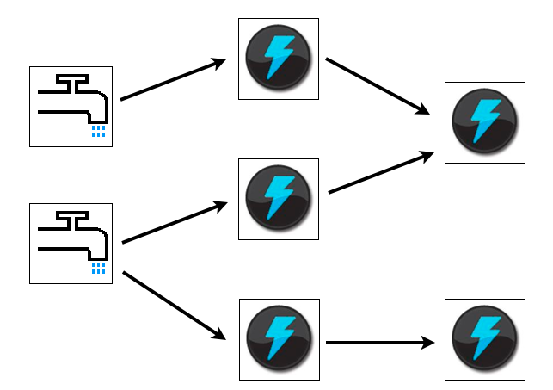
– a distributed real-time computation platform
Set of general primitives for doing real-time computation
Broad set of use cases – from stream processing to distributed RPC
Scalable: add nodes to scale out
Fault tolerant: automatic reassignment of tasks
Programming language agnostic
8
Notes:
8

Slide 9
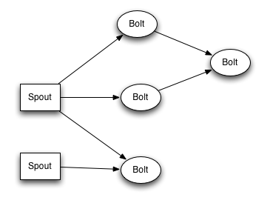
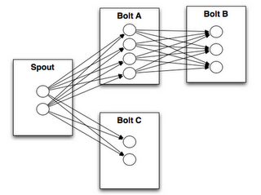
STORM terms and primitives
Stream - an unbounded sequence of tuples
Tuple – a named list of values
Spout - is a source of streams
A bolt –is a processing node
A topology – a network of spouts and bolts

Slide 10

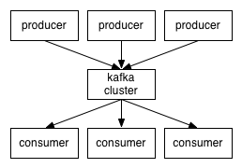
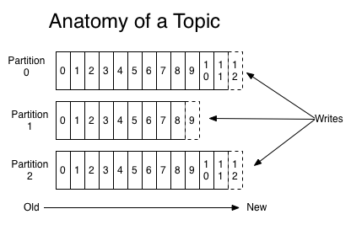
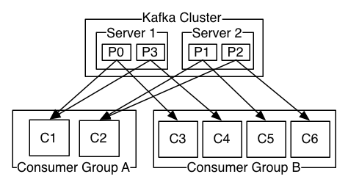
Kafka
Partitioning of fire hose of events into durable brokers with cursors
‘shock absorber’ for massive volumes of events
Both online and batch consumers and producers
Topic based routing
Preserved ordered delivery within same partition
Great performance for durable ordered message delivery:
publish: 500K msgs/sec*
consume: 22K msgs/sec*
Client libraries for all common languages
* - source: http://research.microsoft.com/en-us/um/people/srikanth/netdb11/netdb11papers/netdb11-final12.pdf

Slide 11
SPEEDD Runtime (Traffic Use Case)
Micro-Simulator
micro-sim connector
e.g. update values in simulator
User Interface
sensors
sensor connector
one type of input active (e.g. either file or sim)
Traffic Dashboard client
Actuator
Connectors
.csv file
event file
reader
Dashboard Server
each message is a csv line representing a single event
csv
json
json
json
json
kafka producer/consumer API
speedd-in-events
speedd-out-events
Event Bus
(Kafka)
speedd-actions
speedd-actions-confirmed
storm-kafka-plus
derived/forcasted
events
input events
CEP
suggested
actions
SPEEDD Topology
(STORM)
Decision Making
derived/forcasted
events
DM Controller
Final actions
(feedback)
DM State Estimation
Kafka Topic
Operational
State
SPEEDD
component
state, aggregates
External
component
Notes:
APIs:
http://kafka.apache.org/documentation.html#producerapi – Kafka Producer API

Slide 12
SPEEDD Runtime (Fraud Use Case)
one type of input active
User Interface
transaction history db
db connector
Credit Card Fraud Dashboard client
Action
Consumers
.csv file
event file
reader
Dashboard Server
each message is a csv line representing a single event
csv
json
json
json
json
kafka producer/consumer API
speedd-in-events
speedd-out-events
Event Bus
(Kafka)
speedd-actions
speedd-actions-confirmed
storm-kafka-plus
derived/forcasted
events
input events
CEP
suggested
actions
SPEEDD Topology
(STORM)
Decision Making
derived/forcasted
events
DM Controller
Kafka Topic
SPEEDD
External

Slide 13
SPEEDD Runtime (With ADMIN)
Micro-Simulator
micro-sim connector
e.g. update values in simulator
User Interface
sensors
sensor connector
one type of input active (e.g. either file or sim)
Traffic Dashboard client
Actuator
Connectors
.csv file
event file
reader
Dashboard Server
each message is a csv line representing a single event
csv
json
json
admin directives
json
json
kafka producer/consumer API
Event Bus
(Kafka)
speedd-in-events
speedd-out-events
speedd-admin
speedd-actions
speedd-actions-confirmed
storm-kafka-plus
input events
derived/forcasted
events
CEP
admin directives
suggested
actions
SPEEDD Topology
(STORM)
Decision Making
derived/forcasted
events
DM Controller
Final actions
(feedback)
DM State Estimation
Kafka Topic
Operational
State
SPEEDD
component
state, aggregates
External
component
Notes:
APIs:
http://kafka.apache.org/documentation.html#producerapi – Kafka Producer API

Slide 14
CEP Topology storm-kafka integration
speedd-in-events
Event Bus
(Kafka)
speedd-out-events
csv
json
serializer.class=Json Encoder
KafkaSpout
Kafka Bolt
speed.inEventScheme =Traffic Aggregated Reading Scheme
{key: string, message: Event}
{eventName, timestamp, attrs}
Proton Topology
Proton Output Consumer Bolt
{eventName, attrs}
Notes:
FIXME: ProtonOnStorm uses {Name, attributes} tuple scheme for events. Worth consideration using Event API (org.speedd.data.Event) for better encapsulation and semantics (e.g. Event.getDetectionTime() where detection time is not just one of the attributes). We could possibly make Event part of ProtonOnStorm API.
https://github.com/speedd-project/speedd/issues/2

Slide 15
Integration via Events
All inter-component interactions are via events
listen on topic, receive events
emit events to a topic
Structure:
Event: {Name, attributes, timestamp}
Flexible serialization formats
csv
JSON
{
"timestamp": 1409901066030,
"Name": "PredictedCongestion",
"attributes": {
"density": 1.7333333333333334,
"location": "0024a4dc00003354",
"EventId": "3c391980-a776-4f0c-871d",
"Chronon": null,
"DetectionTime": 1409901066030,
"lane": "fast",
"Cost": 0.0,
"Certainty": 0.5,
"Name": "PredictedCongestion",
"EventSource": "",
"OccurrenceTime": 1409901066030,
"Duration": 0,
"Annotation": "",
"ExpirationTime": null
}
}

Slide 16
Traffic: Sensor Location Enrichment
speedd-in-events
speedd-out-events
speedd-actions
raw sensor readings
derived/forcasted
events
suggested
actions
CEP
PredictedCongestion
Congestion
ClearCongestion
OnRampFlow (over 2-3 min)
Decision Making
DM Controller
APAggregatedReading (running avg over 2-3min)
DM State Estimation
CEP sends onRampFlow for every ramp
DM holds reference data (lookup table) about ramp locations
Upon predicted congestion – lookup the relevant ramp and use its flow value
Operational
State
Location Data
state, aggregates

Slide 17
Traffic – Events sent from CEP
speedd-in-events
speedd-out-events
speedd-actions
raw sensor readings
derived/forcasted
events
suggested
actions
CEP
PredictedCongestion
Congestion
ClearCongestion
OnRampFlow (over 2-3 min)
Decision Making
DM Controller
APAggregatedReading (running avg over 2-3min)
DM State Estimation
CEP sends onRampFlow for every ramp
DM holds reference data (lookup table) about ramp locations
Upon predicted congestion – lookup the relevant ramp and use its flow value
Operational
State
Location Data
state, aggregates

Slide 18
Open Issue: State Management Approach: Log-centric architecture
Kafka
changelog
…
Node 1
…
Node 2
Local State
(replica 1)
Local State
(replica 2)
Every change written to log before “commit” to local replica
Node startup: update local replica from log
Upon new message in log: update local replica
Use log compaction to reduce restore time and log size
Notes:
DM component requires continuously updated aggregations over various attributes in incoming events as well as keeping state information during the run time.
Aggregation computation architecture – proposed approach:
Aggregated values computed as part of the inbound event (stream) processing
Aggregator is a storm (sub)-topology processing a stream of incoming events (traffic sensor readings or credit card transaction events respectively) and updating various aggregated values
The aggregator component may be proprietary (i.e. hard-coded for computing specific formula) or more generic – that’s up to the implementor
State management – proposed approach:
Each stateful node (e.g. DM controller) manages local state, e.g. a key-value store (could be as simple as a local hash map)
The architecture of the local state management is log-centric: all the changes are written to the changelog; all distributed replicas are updated from the log
Owner of this component responsible for its development – ETH, as only DM needs this functionality and also should be in best position to shape the requirements for it.
Read more about log-centric approach:
http://radar.oreilly.com/2014/07/why-local-state-is-a-fundamental-primitive-in-stream-processing.html
http://engineering.linkedin.com/distributed-systems/log-what-every-software-engineer-should-know-about-real-time-datas-unifying

Slide 19
Open Issue: Date & Time
Real vs. Simulated time
replaying a csv file – requires simulated time
currently limitation in Proton – does not allow simulated time
Time Zones
limitation – not supported in Proton

Slide 20
Development Process and Lifecycle
Hosting code on GitHub
Organization: https://github.com/speedd-project
Public Repository: https://github.com/speedd-project/speedd
Issue tracking
Wiki
Build
Maven
Continuous Integration – TBD
Testing
Unit: JUnit, Netflix Curator, Storm and Kafka test modules
Integration: TBD
Performance: TBD
VM as development machine
Just exploring – would it work for us?
Deployment
Explore automation technologies (e.g. Chef, Puppet, Vargant, Wirbelsturm, Docker)

Slide 21
Computing infrastructure
WP6: Architecture and Integration

Slide 22
Performance Test Topology
UI
server
test agent
kafka
broker
storm
supervisor
DM
server
Zookeeper
storm
nimbus

Slide 23
Use Case: Traffic
Use public IaaS cloud infrastructure
Softlayer
Amazon EC²
Evaluation criteria
Price
Consumability – should be easy to use
Automation – minimize effort to setup/configure a new instance of SPEEDD infrastructure
dev/test/demo machine
performance testing
Status – open issue
Registration/Billing – project account? reimbursement?

Slide 24
Use Case: Fraud
On-premise physical/virtual infrastructure
to be provided by FeedZai
physical/virtual environment – to be discussed with FeedZai

Slide 25
open Issues and Next Steps
WP6: Architecture and Integration

Slide 26
Open Issues
Cross-cutting:
Demo scenarios for v1 demo – story-board, patterns, decisions, etc.
Time – real vs. simulated time, time zones
Decision Management
State management (for decision management)
DM design for “Fraud” use case
contact point??
mitigation approach: use CEP for DM
UI
Detailed architecture - TBD
Authoring path
Detailed architecture – TBD
Computing infrastructure
v1 – laptop, not critical

Slide 27
Next Steps
Code Camp
Initial code for integrated prototype (focus on the runtime)
Validate and smoke-test overall architecture
Establish framework for joint work on v1 demo
Agree on demo scenario
Define main tasks and responsibilities, time line
Work to address open issues
UI, DM, Machine Learning

Slide 28
BACKUP

Slide 29
Partitioning of Inbound Events
What should we use for message key for inbound messages to implement efficient partitioning (and load balancing)? Is partitioning good at all for our case?
caveat: message order is guaranteed within partition only
per discussion with Inna (CEP): out of order events will be taken care of by CEP by buffering then for a limited period of time and ordering before they get assigned to the context
Partitioning strategies:
Traffic use case:
by sensor id – uniformly partition by sensor id
by road/zone – break road network into zones and partition by zone id
Fraud use case:
by card_pan

